Slide 1


Photon and Neutron Open Science Cloud
EOSC
for Photon and Neutron Facility’ Users
Jean-François Perrin (Institut Laue – Langevin)
EOSC-hub week – Prague - 10th Apr 2019

Slide 2
Who are we
50,000 users – Biology, Medicine, Materials, Chemistry, Nuclear Physics, Particle Physics, Cultural heritage, Geology … and industrial applications.
State of the art Large Scale Facilities – 5 ESFRIs + 25 national RIs (PaNs)
Data policies implementing FAIR principles – PaNdata data policy
10s of Petabytes of scientific data, curated and archived for 5-10+ years
PaNs manage and provide access to data from experiments across Europe
Working together PaNOSC + ExPANDS
This project has received funding from the European Union's Horizon 2020 research and innovation programme under grant agreement No 823852

Slide 3
Why FAIR for a user facility?
Promise of even higher scientific/societal impact
Keys metrics of a scientific User Facility :
Nb of scientific proposals submitted (attractiveness)
Nb and IF of scientific articles published using the experimental data (impact measurement).
Professional management of the production, like in any company
Transparency and trust for our scientific output
Better services for the facility users:
Data are organized and easily accessible at any time
Metadata are standardized and structured
Easily citeable - Some journals request access to data for every article
Facilitate Data Management Plan
This project has received funding from the European Union's Horizon 2020 research and innovation programme under grant agreement No 823852

Slide 4

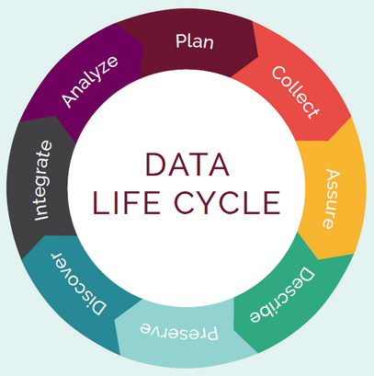

KPIs - Before PaNOSC - 2018
 | ILL | ESRF | CERIC | XFEL | ELI | ESS
Data / yr | 200 TB | 8 PB | 1 PB | 3PB | < 1 PB | 0
Data Policy | 2011 | 2016 | 2014 (3/8) | 2017 | In progress | 2017
Metadata catalogue | Local | Icat | Local | myMdC | No | SciCat
Metadata definitions | Nexus | Nexus | custom | myMdC | ? | Nexus
DOI | 2012 | 2018 | No | 2018 | No | 2018
Open Data | Yes | Yes | No | Yes | No | No
Data analyses Services | Pilot | In progress | Remote | In progress | ? | In progress
Common data API | No | No | No | No | No | No
User training | No | No | No | No | No | No

Slide 5
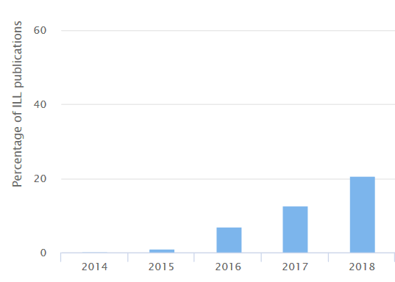
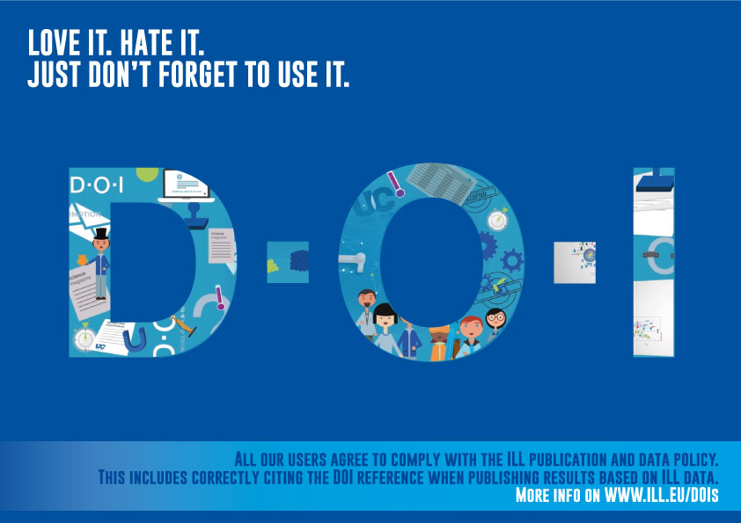
Current status of FAIR user adoption
User adoption in progress, but still slow to come.
Concepts still new for a large number of users.
Metrics: how successful are we?
Rewarding ?
EOSC critical mass
How many ILL users’ publications are referencing data DOIs

Slide 6
KPIs - After PaNOSC - 2023
 | ILL | ESRF | CERIC | XFEL | ELI | ESS
Data / yr | 600 TB | 50 PB | 15 PB | 100PB | 10 PB | <1PB
Data Policy | 2011 | 2016 | 2019 | 2017 | 2019 | 2017
Metadata catalogue | Local | Icat | Icat | myMdC | [TBD] | SciCat
Metadata | Nexus | Nexus | Nexus | Nexus | [Nexus] | Nexus
Metadata collection | All BLs | All BLs | All BLs | All BLs | All BLs | All BLs
DOI | Yes | Yes | Yes | Yes | Yes | Yes
Open Data | Yes | Yes | Yes | Yes | Yes | Yes
Common API | Yes | Yes | Yes | Yes | Yes | Yes
User training | Yes | Yes | Yes | Yes | Yes | Yes
Data Services | Prod | Prod | Prod | Prod | Prod | Prod
EOSC | Integrated | Integrated | Integrated | Integrated | Integrated | Integrated

Slide 7
Examples of open questions, challenges and opportunities for collaboration.
This project has received funding from the European Union's Horizon 2020 research and innovation programme under grant agreement No 823852

Slide 8
Actions regarding FAIR data, opportunities for collaborations
Update our community Data Policy Framework (PaNData 2008)
Compare with latest FAIR principles
Take into account new services
…
Implement standard API on our (meta)data catalogue and federated search on (meta)data
Extend NeXus metadata standards to enhance interoperability.
Implement DMP template (provide users with an easy way to fill in DMPs)
Continue to complete metadata environment (e-logbook, samples information, …)
Promoting FAIR data culture, train scientists on how to create and use FAIR data.
Setting clear and open metrics.
This project has received funding from the European Union's Horizon 2020 research and innovation programme under grant agreement No 823852

Slide 9
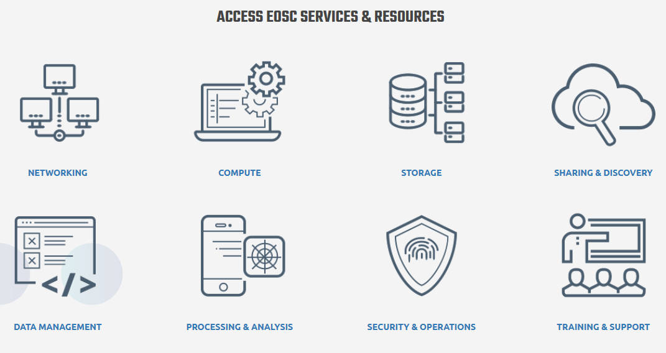
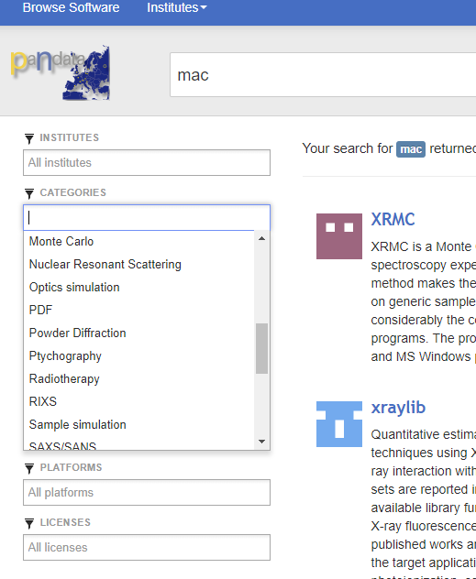
EOSC Portal, integrate model?
In its current form, it looks very much like an IT service portfolio
How do we integrate this Portal?
At the Service Level?
Do we link to our community portals?
Do we integrate into other communities’ portal?
IS EOSC a way to help us to build our community portal?
This project has received funding from the European Union's Horizon 2020 research and innovation programme under grant agreement No 823852

Slide 10
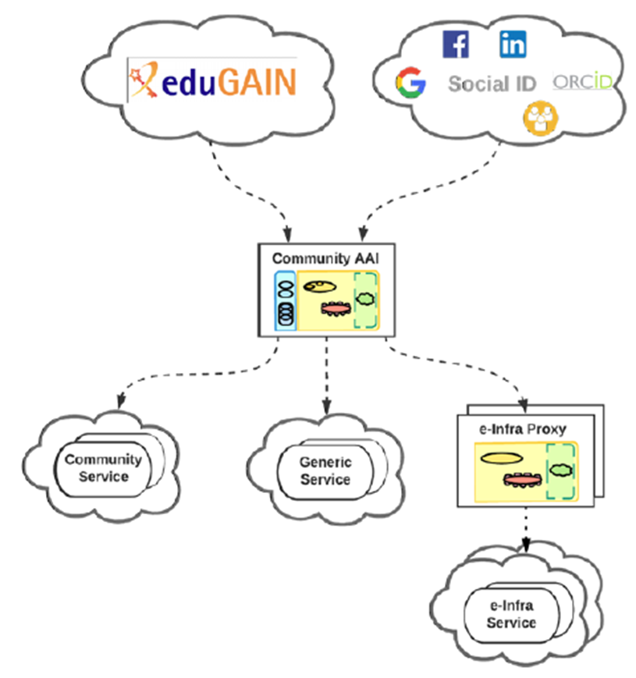



AAI – Typical use case – EGI Notebook service
Work in progress with EGI and GÉANT
Autorisation Model
User friendly
Data archives at RI
This project has received funding from the European Union's Horizon 2020 research and innovation programme under grant agreement No 823852

Slide 11
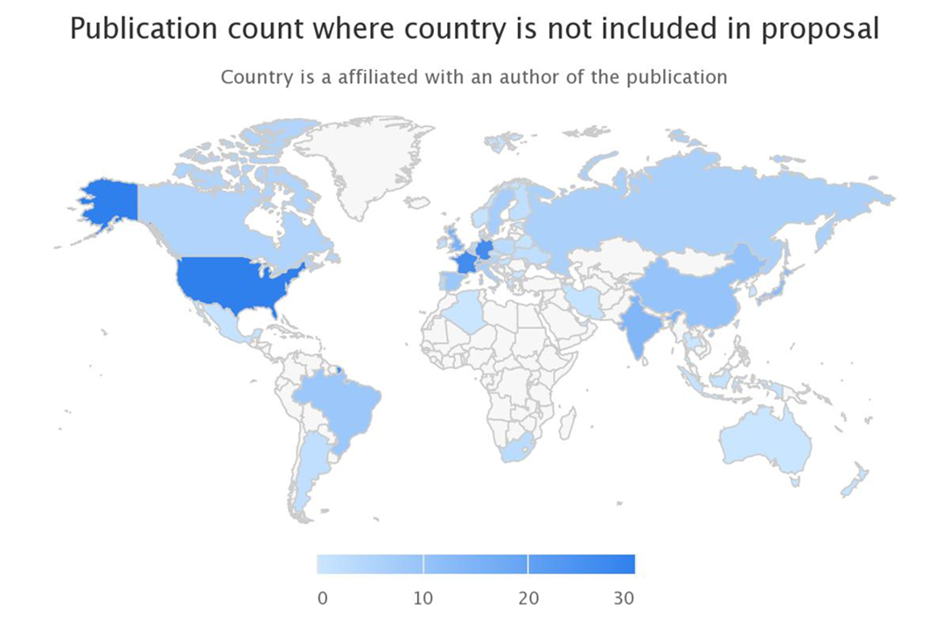
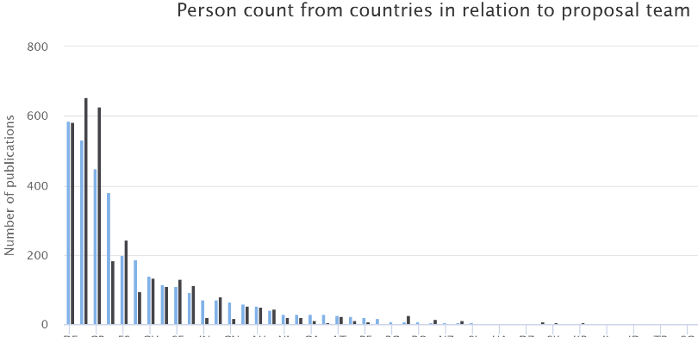
Sustainability?
Sustainability will come if FAIR data are re-used and contribute to increase knowledge at a reasonable cost.
How to prove evidence?
We had to develop our of tool
to track usage of data. (not
limited to OpenAccess)
Is it not of general interest?
Data-sources
Document
Corpus creation
Corpus of
document
Document analysis
Enhanced
document
Document matching
Match
candidate
Human validation
Match
Statistics computation
Result
presentation
This project has received funding from the European Union's Horizon 2020 research and innovation programme under grant agreement No 823852

Slide 12
Photon and Neutron Open Science Cloud
Work is going on.
Keep in touch: contact@panosc.eu
https://github.com/panosc-eu/panosc/tree/master/Work%20Packages

